Slide 1
Introduction to Image Processing using Python

Slide 2
Images in Python
Images are matrices!
Many useful built-in functions in the octave Image Processing Package
Very easy to write your own image processing functions
<number>

Slide 3
2D matrix
2D matrix has M rows and N columns
Example
>>m=np.zeros(400,200);
>>m[0:50,0:100] = 1;
Note:
0 to M-1
Origin of coordinate system is in upper left corner
Row index increases from top to bottom
c
0
1
…
N-1
0
1
…
M -1

Slide 4
Image Types Cont.
TrueColor
every image pixel has three values associated with it: the red, green, and blue components.
It’s represented with 3-Dimensional array of size MxNx3
Notes:
You can see that with a truecolor image, the values of the array specify the color of each image pixel directly. This form of representation gives you the most control over the display, but it may not be the most appropriate image type to use for engineering and scientific data
<number>

Slide 5
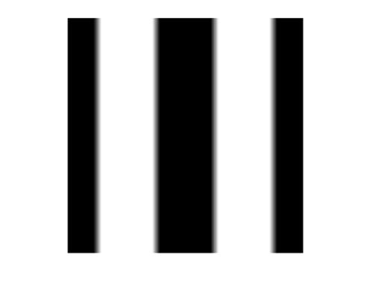

Image Types Cont.
Grayscale Image
only brightness information

Slide 6
Image Types Cont.
Binary Image
Black and white pixels
Image toolbox treat logical matrix as binary image (0’s & 1’s)
Is used as a mask
An image mask divides the pixels into 2 sets
Notes:
An imagemask divides the pixels into two sets. One set, typically the white pixels, contains the locations of interest. For example, the white pixels might indicate detected objects. The other set indicates the background locations.
<number>

